Slide 1
Investigate CPU Usage using Factorial Experiment
STA305 Final Project, L2021, W2022
Yuchen Zeng, 1006101825, Statistic Major

Slide 2


Introduction

Slide 3
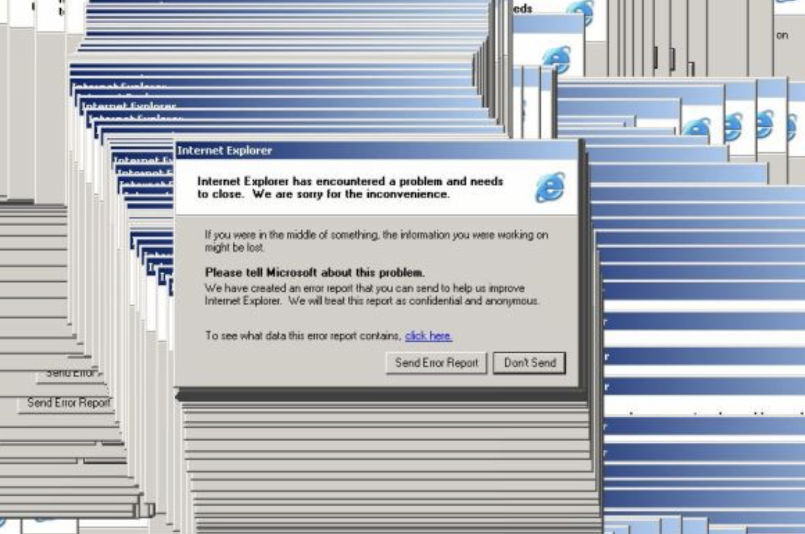

Slide 4
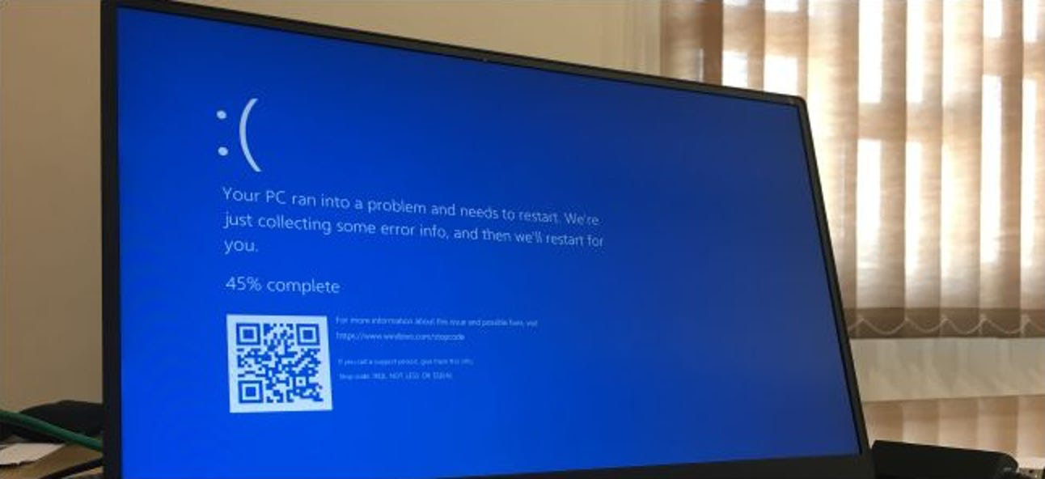

Slide 5
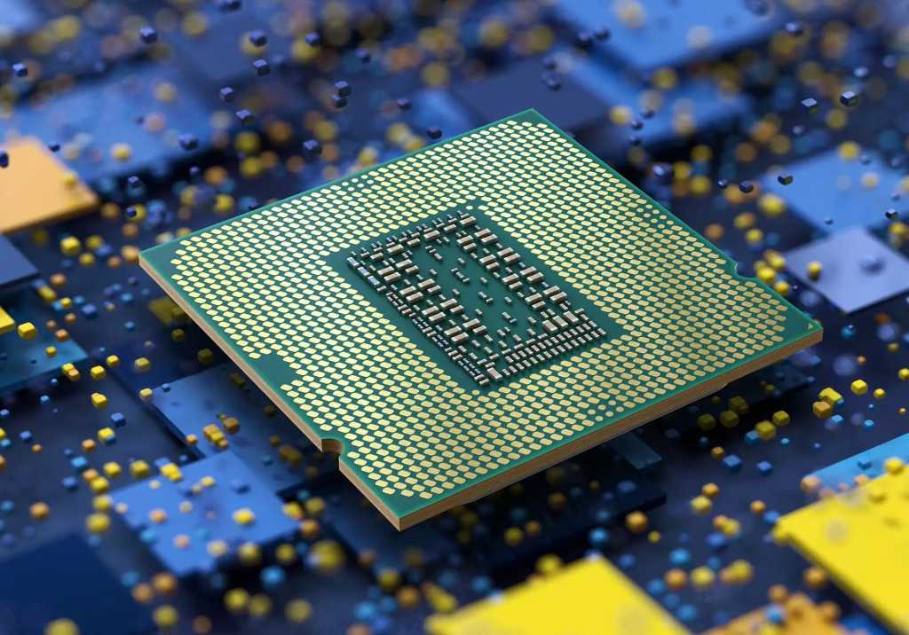

High CPU Usage

Slide 6
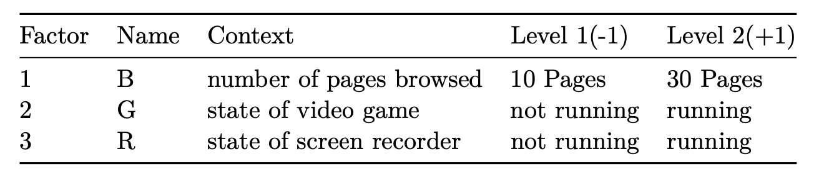
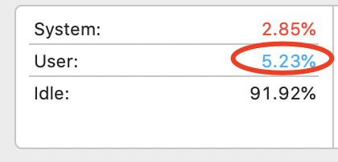
Experimental Design
Major Usage: Browse online, play video games, or record my screen
y: CPU usage in percentage
2 replicated runs

Slide 7
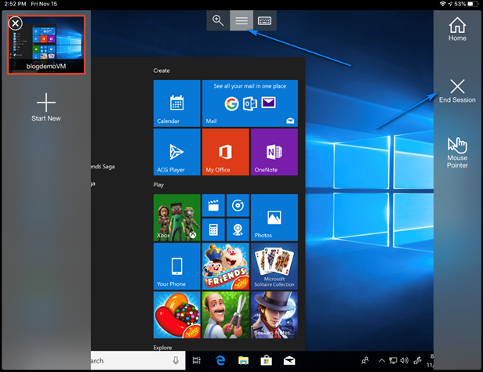
Record the data
Azure
Different virtual computer
Wait for 15 minutes
16 observations

Slide 8
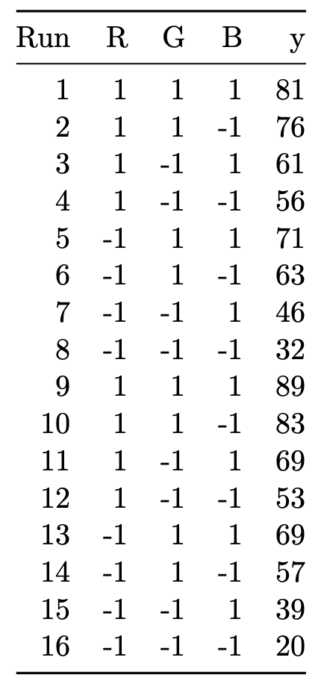
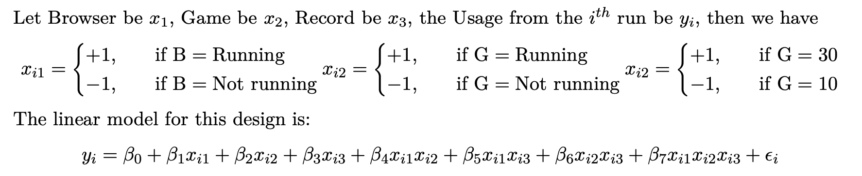
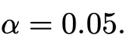
Statistical Methods
Cube plot
Linear model
Significant level
Hypothesis testing
Confidence interval
Main effect, interaction effect, variance of effect
Interaction plot, Half-normal plot

Slide 9
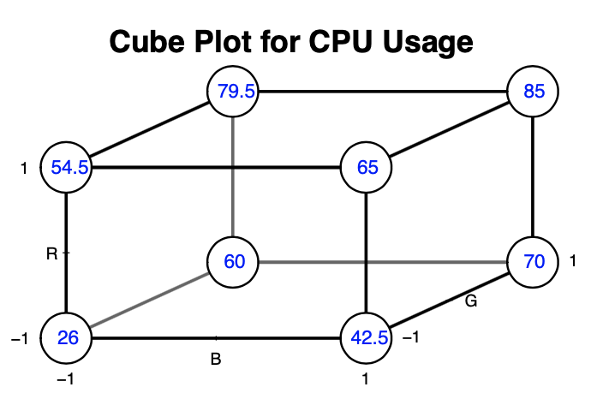
Result

Slide 10
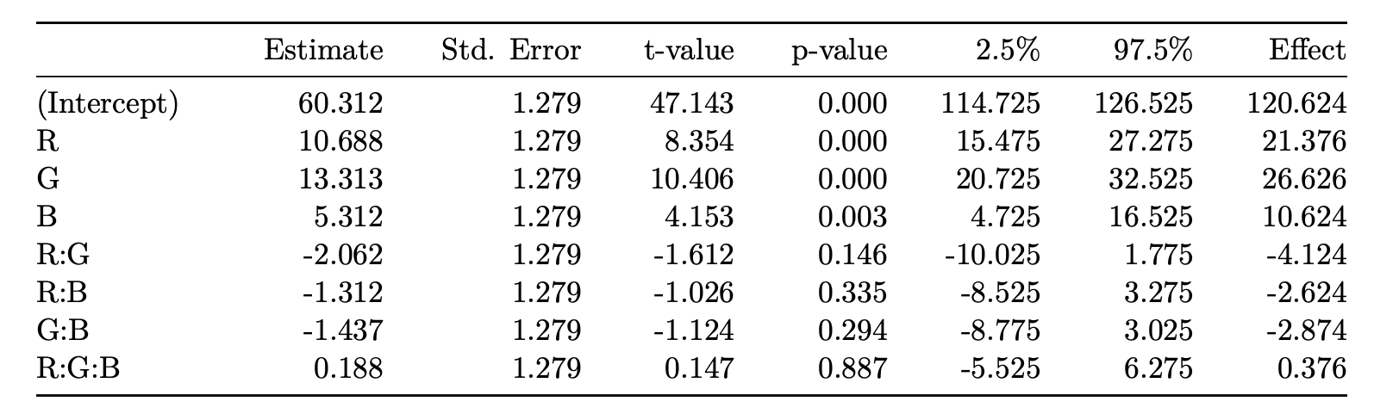
Only R, G, B have p-values < 0.05
Reject null hypothesis that there is no effect
Main effect: the mean CPU usage
increases by 21.38% when we run the screen recorder
increases by 26.625% when we run the video game
increases by 10.625% when we browse 30 pages compared to browsing 10 pages.

Slide 11
95% Confidence interval
Interaction effects: include 0
(20.725, 32.525) for running the video game
(15.475, 27.275) for running the screen recorder
(4.725, 16.525) for browsing 30 pages compared to 10 pages.
Var(effect) =1.636

Slide 12
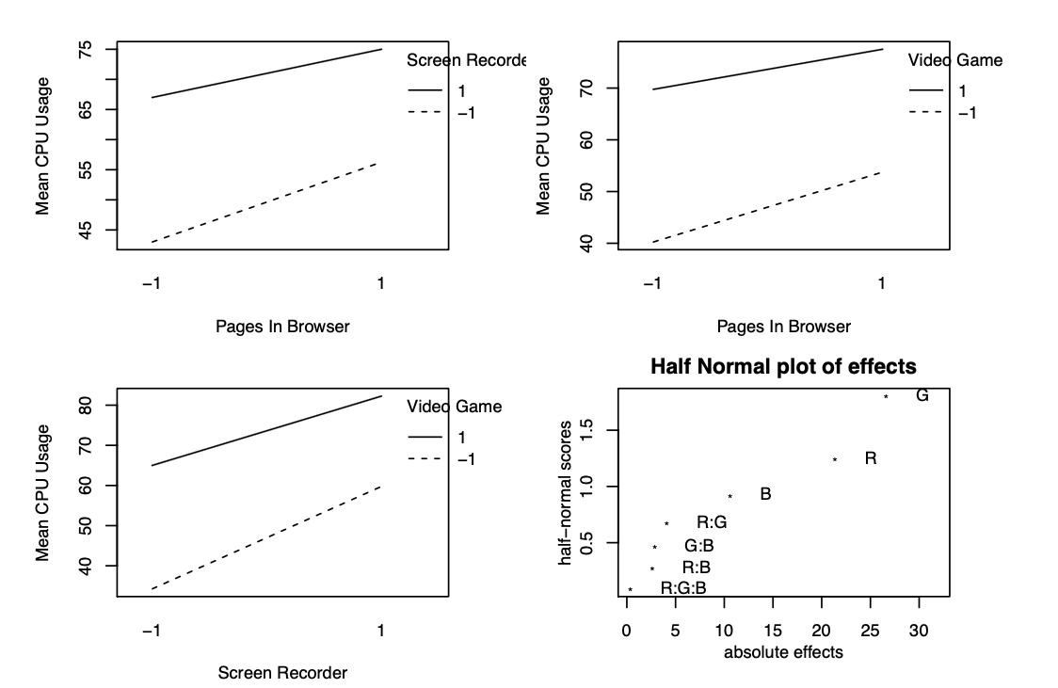

Slide 13
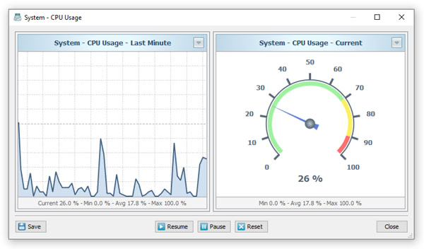
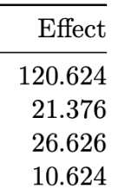
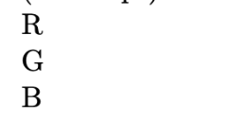
Conclusion
Running the video game, running the screen recorder, and opening 30 pages compared to 10 pages increases CPU usage.
Video Game > Screen Recorder > Browsing pages
No interaction between effects
Safe to browse many pages
Avoid running multiple tasks when running the video game or the screen recorder

